Slide 1
MedEase
A Blockchain-Based Medical Web Application\
Project Design
Team Members:
Chowdhury Nafis Faiyaz
ID: 1931841642
Ayman Ibne Hakim
ID: 2013364042

Slide 2
Problem Statement and Solution
Problem Statement- Healthcare data is often isolated and fragmented, making it difficult for patients and healthcare providers to access and share information. This can lead to errors, delays, and inefficiencies in the treatment process.
Solution: The blockchain-based medical web application solves this problem by securely storing patients' medical records on a tamper-proof blockchain. This ensures that data is always accurate and up-to-date, and that it can be easily accessed by authorized parties. The decentralized nature of the blockchain also guarantees that patients have control over their data, and that it is compliant with data regulations.
Benefits: The blockchain-based medical web application offers a number of benefits for patients and healthcare providers, including:
Increased data accuracy and integrity
Improved efficiency in the treatment process
Reduced administrative costs
Enhanced patient privacy and control
Increased compliance with data regulations

Slide 3
What is MedEase?
Blockchain based Centralized Healthcare application
Revolutionize healthcare with our cutting-edge blockchain-based medical web application.
This platform will securely store patients' medical records, treatment histories, and diagnostic reports on a tamper-proof blockchain, ensuring data integrity and privacy.
Patients can seamlessly grant healthcare providers access to their records, streamlining the treatment process and reducing administrative hurdles.
The decentralized nature of the blockchain guarantees that medical data remains under patients' control, enhancing trust and compliance with data regulations.

Slide 4
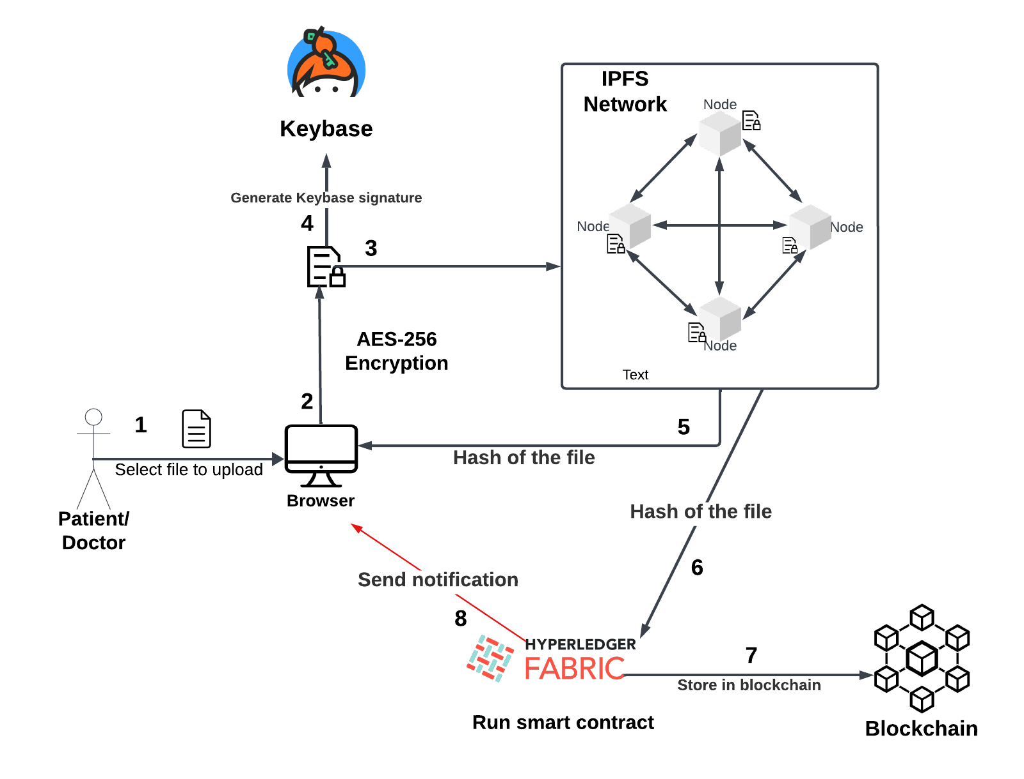
How do we use blockchain for file storage?
In our proposed system, we plan to combine several technologies to create a secure and decentralized infrastructure for managing files and encryption keys:
Hyperledger Fabric: This is the foundation of our private blockchain network. It's a permissioned blockchain platform designed for enterprise applications. Only authorized nodes can participate, ensuring security and control.
IPFS (InterPlanetary File System): We'll use IPFS to store files in a decentralized manner. IPFS operates through a peer-to-peer network, making it resilient and efficient for file storage and sharing.
Keybase: Keybase serves as the platform for verifying online identities and securely sharing encrypted files and messages. Users link their online identities to a public key, and encryption keys for files will be stored in Keybase. Doctors can request these keys from the patient to access the files.

Slide 5
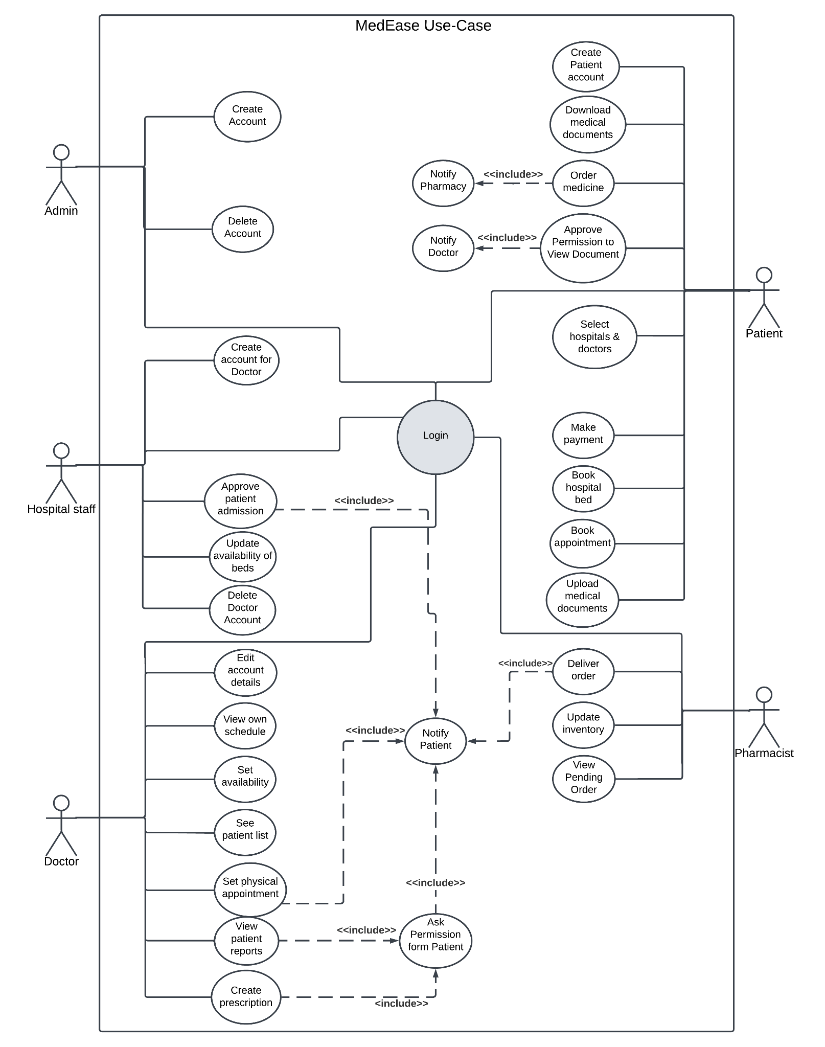
Use-Case diagram

Slide 6
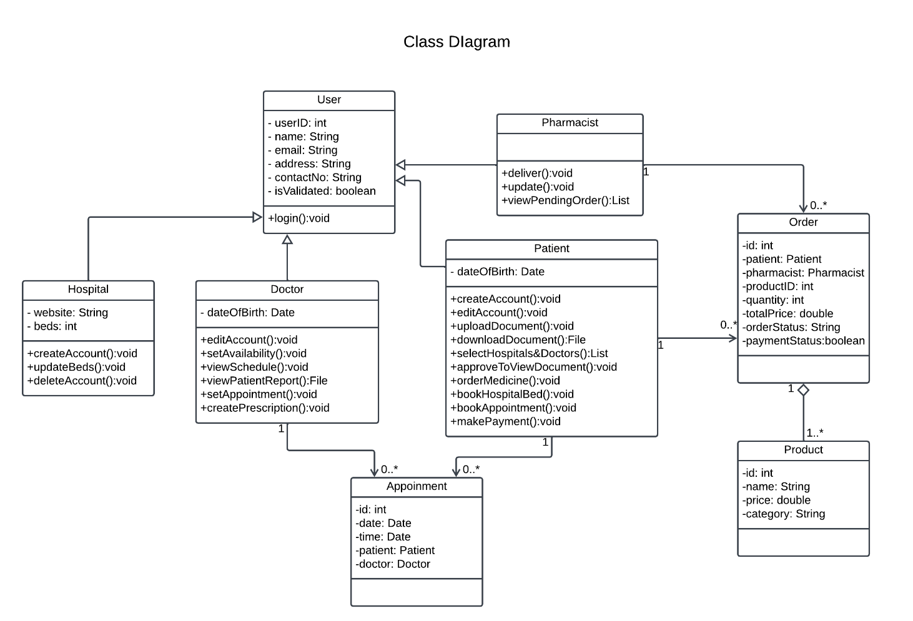
Class diagram

Slide 7
Environmental and social effects And Ethical and professional Responsibility
Environmental Effects:
Reduced Paper Usage
Energy Consumption
E-Waste Generation
Data Centers' Carbon Footprint
Social Effects:
Improved Patient Care
Enhanced Efficiency
Data Security and Privacy
Access Disparities
Workforce Impact
Ethical Considerations
Ethical and Professional Responsibility:
Principle 1.2: Avoid Harm.
Principle 1.6: Respect Privacy.
Principle 1.7: Honor Confidentiality.
Principle 2.1: Strive to achieve high quality in both the processes and products of professional
Principle 2.4: Communicate professionally and honestly with others.
Principle 2.5: Consider potential impacts of computing work on society.
Principle 2.9: Design and implement systems that are robustly and usably secure.

Slide 8
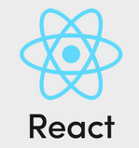



Tech Stack
Front End
Back End

Slide 9
Proposed Working plan
Stage 1 Completed✅ | Stage 2 Completed✅ | Stage 3 Completed✅ | Stage 4 Completed✅ | Stage 5 | Stage 6 | Stage 7
Exploring Related Works | 1. Planning and Features & Functionality Selection (Use Cases) 2. Understand the requirements | 1. Identify the components. Define the interaction Document the design. | System designs and diagrams | Application development November-March | Testing and deployment March | Paper Publication May

